Slide 1
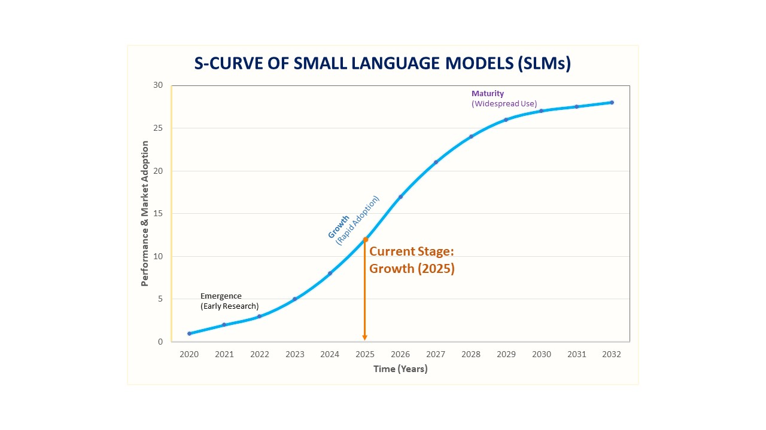
Possible Decline or Transition

